Slide 1

EE904 - Deep Learning for Communications
eMasters – Q3-2023-24
IIT Kanpur
Venkateswar Reddy Melachervu
CTO
10th Dec 2023
Brillium Technologies
#501, C Block, Salarpuria Serenity, 5th Main, Sector 7, HSR Layout, Bengaluru 560102, Karnataka, India
Website: www.brillium.in | Email: connect@brillium.in

Slide 2
Module Content
Introduction and applications of AI, ML and DL
DL applications and concepts in communications
Mathematical basics for ML
Regression and Classification
Neural networks and optimization algorithms
Convolutional neural networks
State of the art CNN architectures
Feature representation and learning
Programming demo application (python)
Ground penetrating radars and applications
Input signals representation and classification (audio, image)
Millimeter-waves and object detection
Load balancing and optimal resource allocation
Optical communication and pattern recognition
Wi-Fi and indoor localization
AI for satellite communication

Slide 3
Intro Applications of AI and ML
AI
Ability to replicate or enhance human intellect – reasoning and learning from experience
Uses – probability theory, linear algebra, signal processing, algorithms
ML
Is a sub-set of AI
DL
Is a sub-set of ML
Ground Penetrating RADAR
GPR1 – 10 MHz – 500 MHz
GPR2 – 800 MHz – 1.2 GHz
GPR1 – 400 MHz – 600 MHz
Timeline of AI
1950s – 1970s – AI, Initial Neural Networks
1980s – 2006s – ML, Back-propagation, learning from experience/ground truth/data etc.
2010s – 2017s – DL, CNN, etc.
AI
Sense
Vision, Audio processing
Comprehend
NLP
Knowledge representation
Act
ML – Reinforcement learning
Expert systems

Slide 4
Applications of AI in Communication
Mobility management
Sensing and localization
Smart signaling
Interference management
AI-enabled Air Interface – Qualcomm Snapdragon X70 5G RF Modem
GAN – Can generate new data similar to underlying distribution where it is trained on
Wifi Indoor localization
Data clustering
Base station switching control
User association and routing
Channel estimation
Signal detection
Modulation recognition

Slide 5
ML
To optimize a performance criterion using example data or past experience
Types
Supervised
Unsupervised
Reinforcement learning – Rewards and penalty structure needs to be specified per environment
RL
Aims to learn an optimal control policy via interactions with the system/environment
Agent will take control actions based on the current observations of environment states and receive the corresponding rewards from the environment

Slide 6
DL
Sub-set of ML – Neural networks
3 or more layers
Attempt to simulate human brain – neuron
Medical image analysis
Input image ➔ Convolution layer ➔ Pooling layer ➔ ANN ➔ Output

Slide 7
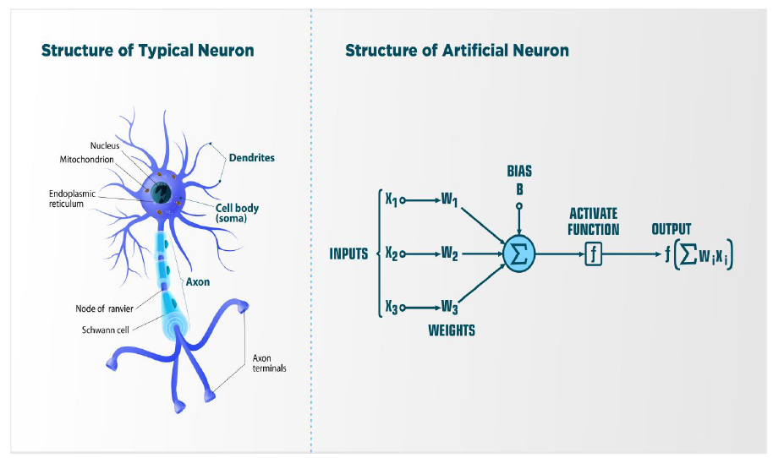
Neural Networks
ANNs learn by examples
At least 3 layers to regress input data

Slide 8
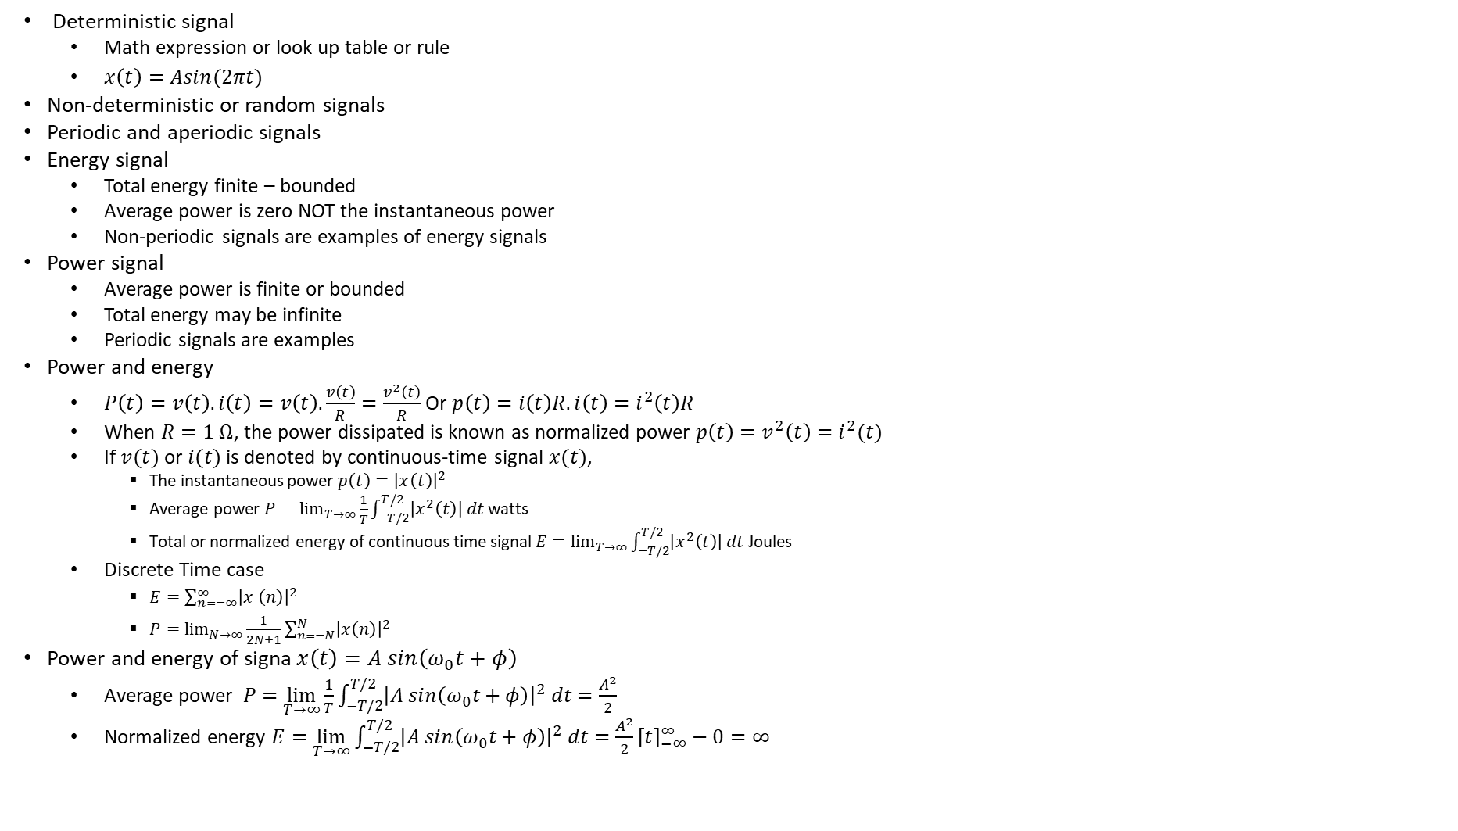
Signals
Deterministic signal
Math expression or look up table or rule
$x\left(t\right)=Asin(2πt)$
Non-deterministic or random signals
Periodic and aperiodic signals
Energy signal
Total energy finite – bounded
Average power is zero NOT the instantaneous power
Non-periodic signals are examples of energy signals
Power signal
Average power is finite or bounded
Total energy may be infinite
Periodic signals are examples
Power and energy
$P\left(t\right)=v\left(t\right).i\left(t\right)=v\left(t\right).\frac{v\left(t\right)}{R}=\frac{v^{2}\left(t\right)}{R}$Or $p\left(t\right)=i\left(t\right)R.i\left(t\right)=i^{2}\left(t\right)R$
When $R=1 Ω$, the power dissipated is known as normalized power $p\left(t\right)=v^{2}\left(t\right)=i^{2}(t)$
If $v(t)$ or $i(t)$ is denoted by continuous-time signal $x(t)$,
The instantaneous power $p\left(t\right)={\left|x\left(t\right)\right|}^{2}$
Average power $P=\lim_{T→∞}{\frac{1}{T}\int_{−T/2}^{T/2}{\left|x^{2}\left(t\right)\right| dt}}$ watts
Total or normalized energy of continuous time signal $E=\lim_{T→∞}{\int_{−T/2}^{T/2}{\left|x^{2}\left(t\right)\right| dt}}$ Joules
Discrete Time case
$E=\sum_{n=−∞}^{∞}{{\left|x^{ }\left(n\right)\right|}^{2}}$
$P=\lim_{N→∞}{\frac{1}{2N+1}\sum_{n=−N}^{N}{{\left|x\left(n\right)\right|}^{2}}}$
Power and energy of signa $x\left(t\right)=A sin\left(ω_{0}t+φ\right)$
Average power $P=$ $\lim_{T→∞}{\frac{1}{T}\int_{−T/2}^{T/2}{{\left|A sin\left(ω_{0}t+φ\right)\right|}^{2} dt}}=\frac{A^{2}}{2}$
Normalized energy $E=\lim_{T→∞}{\int_{−T/2}^{T/2}{{\left|A sin\left(ω_{0}t+φ\right)\right|}^{2} dt}}=\frac{A^{2}}{2}{\left[t\right]}_{−∞}^{∞}−0=∞$

Slide 9
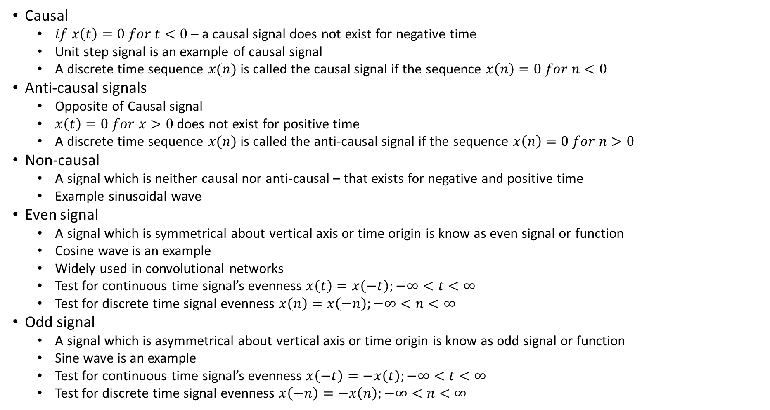
Signals
Causal
$if x\left(t\right)=0 for t<0$ – a causal signal does not exist for negative time
Unit step signal is an example of causal signal
A discrete time sequence $x(n)$ is called the causal signal if the sequence $x\left(n\right)=0 for n<0$
Anti-causal signals
Opposite of Causal signal
$x\left(t\right)=0 for x>0$ does not exist for positive time
A discrete time sequence $x(n)$ is called the anti-causal signal if the sequence $x\left(n\right)=0 for n>0$
Non-causal
A signal which is neither causal nor anti-causal – that exists for negative and positive time
Example sinusoidal wave
Even signal
A signal which is symmetrical about vertical axis or time origin is know as even signal or function
Cosine wave is an example
Widely used in convolutional networks
Test for continuous time signal’s evenness $x\left(t\right)=x\left(−t\right);−∞<t<∞$
Test for discrete time signal evenness $x\left(n\right)=x\left(−n\right);−∞<n<∞$
Odd signal
A signal which is asymmetrical about vertical axis or time origin is know as odd signal or function
Sine wave is an example
Test for continuous time signal’s evenness $x\left(−t\right)=−x\left(t\right);−∞<t<∞$
Test for discrete time signal evenness $x\left(−n\right)=−x\left(n\right);−∞<n<∞$

Slide 10
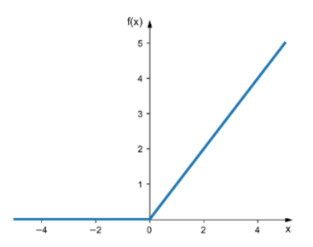
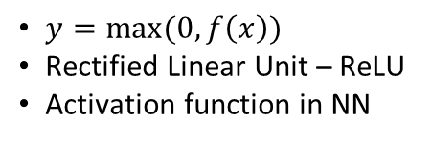
Signals
Neither even nor odd signals
$y=max⁡(0,f\left(x\right))$
Rectified Linear Unit – ReLU
Activation function in NN

Slide 11

AM
Modulating signal $m\left(t\right)=A_{m}cos⁡(2πf_{m}t)$, carrier signal $c\left(t\right)=A_{c}\cos\left(2πf_{c}t\right)$
The amplitude modulated wave is $s\left(t\right)=\left[A_{c}+A_{m}\cos\left(2πf_{m}t\right)\right]\cos{(2πf_{c}t)}$

Slide 12
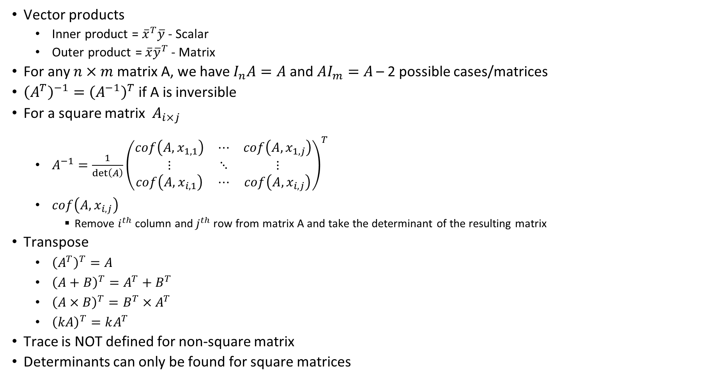
Mathematical Basics
Vector products
Inner product = ${\overline{x}}^{T}\overline{y}$ - Scalar
Outer product = $\overline{x}{\overline{y}}^{T}$ - Matrix
For any $n×m$ matrix A, we have $I_{n}A=A$ and $AI_{m}=A$ – 2 possible cases/matrices
${\left(A^{T}\right)}^{−1}={\left(A^{−1}\right)}^{T}$ if A is inversible
For a square matrix $A_{i×j}$
$A^{−1}=\frac{1}{\det\left(A\right)}{\left(\begin{matrix}cof\left(A, x_{1,1}\right) & ⋯ & cof\left(A,x_{1,j}\right) \\ ⋮ & ⋱ & ⋮ \\ cof\left(A,x_{i,1}\right) & ⋯ & cof\left(A,x_{i,j}\right)\end{matrix}\right)}^{T}$
$cof\left(A,x_{i,j}\right)$
Remove $i^{th}$ column and $j^{th}$ row from matrix A and take the determinant of the resulting matrix
Transpose
${\left(A^{T}\right)}^{T}=A$
${\left(A+B\right)}^{T}=A^{T}+B^{T}$
${\left(A×B\right)}^{T}=B^{T}×A^{T}$
${\left(kA\right)}^{T}=kA^{T}$
Trace is NOT defined for non-square matrix
Determinants can only be found for square matrices

Slide 13
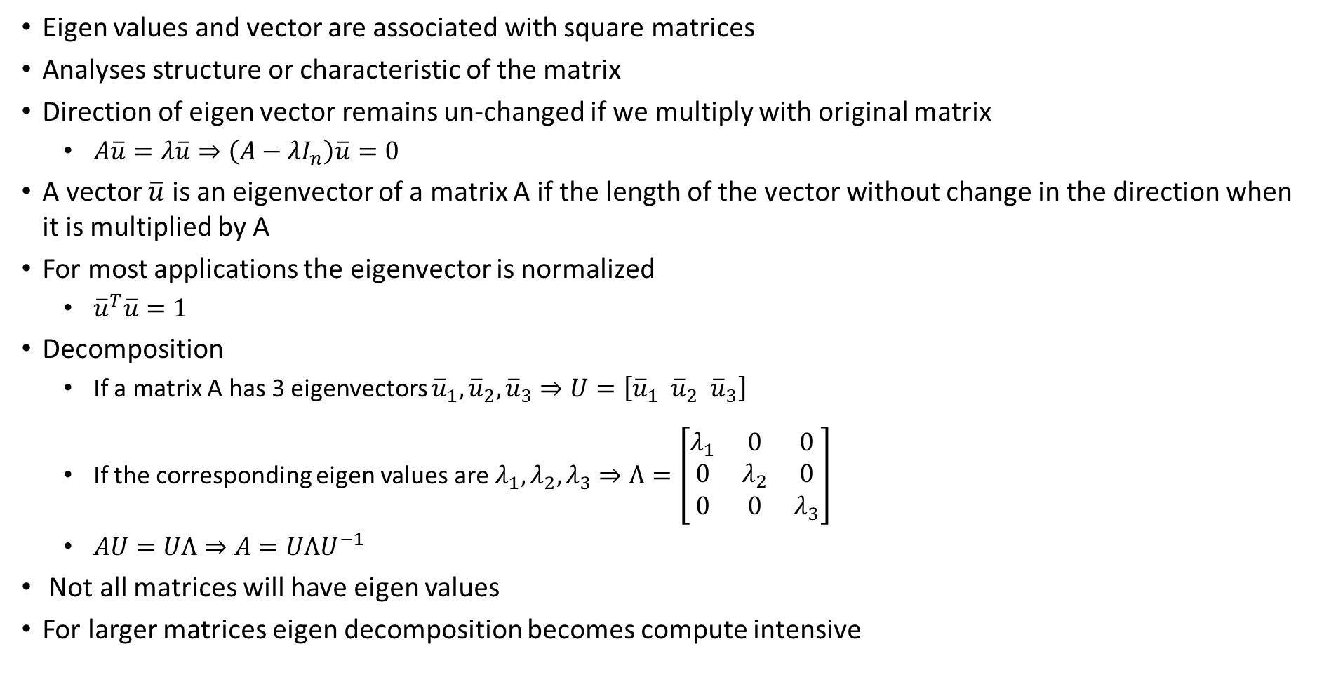
Eigen Decomposition
Eigen values and vector are associated with square matrices
Analyses structure or characteristic of the matrix
Direction of eigen vector remains un-changed if we multiply with original matrix
$A\overline{u}=λ\overline{u}⇒\left(A−λI_{n}\right)\overline{u}=0$
A vector $\overline{u}$ is an eigenvector of a matrix A if the length of the vector without change in the direction when it is multiplied by A
For most applications the eigenvector is normalized
${\overline{u}}^{T}\overline{u}=1$
Decomposition
If a matrix A has 3 eigenvectors ${\overline{u}}_{1}, {\overline{u}}_{2}, {\overline{u}}_{3}⇒U=\left[{\overline{u}}_{1} {\overline{u}}_{2} {\overline{u}}_{3}\right]$
If the corresponding eigen values are $λ_{1}, λ_{2}, λ_{3}⇒Λ=\left[\begin{matrix}λ_{1} & 0 & 0 \\ 0 & λ_{2} & 0 \\ 0 & 0 & λ_{3}\end{matrix}\right]$
$AU=UΛ⇒A=UΛU^{−1}$
Not all matrices will have eigen values
For larger matrices eigen decomposition becomes compute intensive

Slide 14

ML Basics
A computer program is said to learn from experience $E$ with respect to some class of tasks $T$ and performance measure $P$, if its performance measured at tasks in T, as measured by $P$, improves with experience $E$
Classification with missing inputs
Learn probability distribution over all of the relevant variables, then solve the classification task by marginalizing out the missing variables

Slide 15
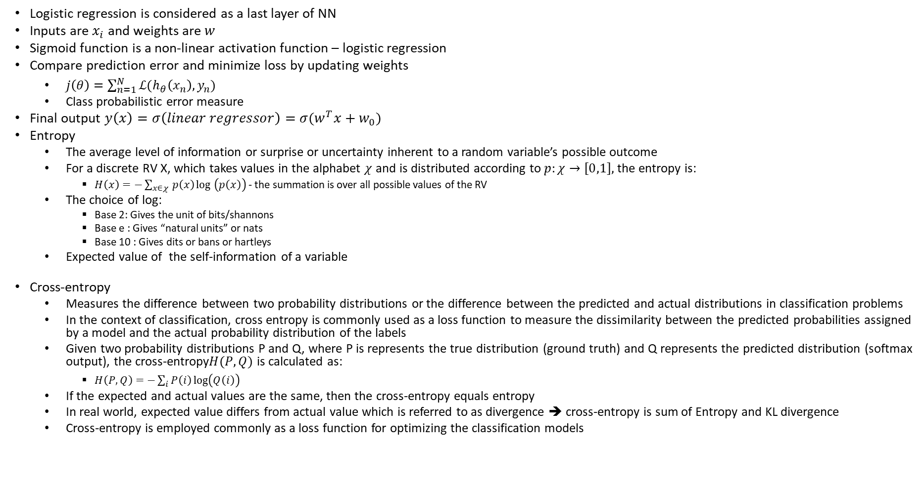
Regression and Classification – Entropy and Cross-Entropy
Logistic regression is considered as a last layer of NN
Inputs are $x_{i}$ and weights are $w$
Sigmoid function is a non-linear activation function – logistic regression
Compare prediction error and minimize loss by updating weights
$j\left(θ\right)=\sum_{n=1}^{N}{ℒ(h_{θ}\left(x_{n}\right), y_{n})}$
Class probabilistic error measure
Final output $y\left(x\right)=σ\left(linear regressor\right)=σ(w^{T}x+w_{0})$
Entropy
The average level of information or surprise or uncertainty inherent to a random variable’s possible outcome
For a discrete RV X, which takes values in the alphabet $χ$ and is distributed according to $p:χ→\left[0,1\right],$ the entropy is:
$H\left(x\right)=−\sum_{x∈χ }^{ }{p\left(x\right)\log_{ }\left(p\left(x\right)\right)}$ - the summation is over all possible values of the RV
The choice of log:
Base 2: Gives the unit of bits/shannons
Base e : Gives “natural units” or nats
Base 10 : Gives dits or bans or hartleys
Expected value of the self-information of a variable
Cross-entropy
Measures the difference between two probability distributions or the difference between the predicted and actual distributions in classification problems
In the context of classification, cross entropy is commonly used as a loss function to measure the dissimilarity between the predicted probabilities assigned by a model and the actual probability distribution of the labels
Given two probability distributions P and Q, where P is represents the true distribution (ground truth) and Q represents the predicted distribution (softmax output), the cross-entropy$H(P,Q)$ is calculated as:
$H\left(P,Q\right)=−\sum_{i}^{ }{P\left(i\right)\log\left(Q\left(i\right)\right)}$
If the expected and actual values are the same, then the cross-entropy equals entropy
In real world, expected value differs from actual value which is referred to as divergence ➔ cross-entropy is sum of Entropy and KL divergence
Cross-entropy is employed commonly as a loss function for optimizing the classification models

Slide 16
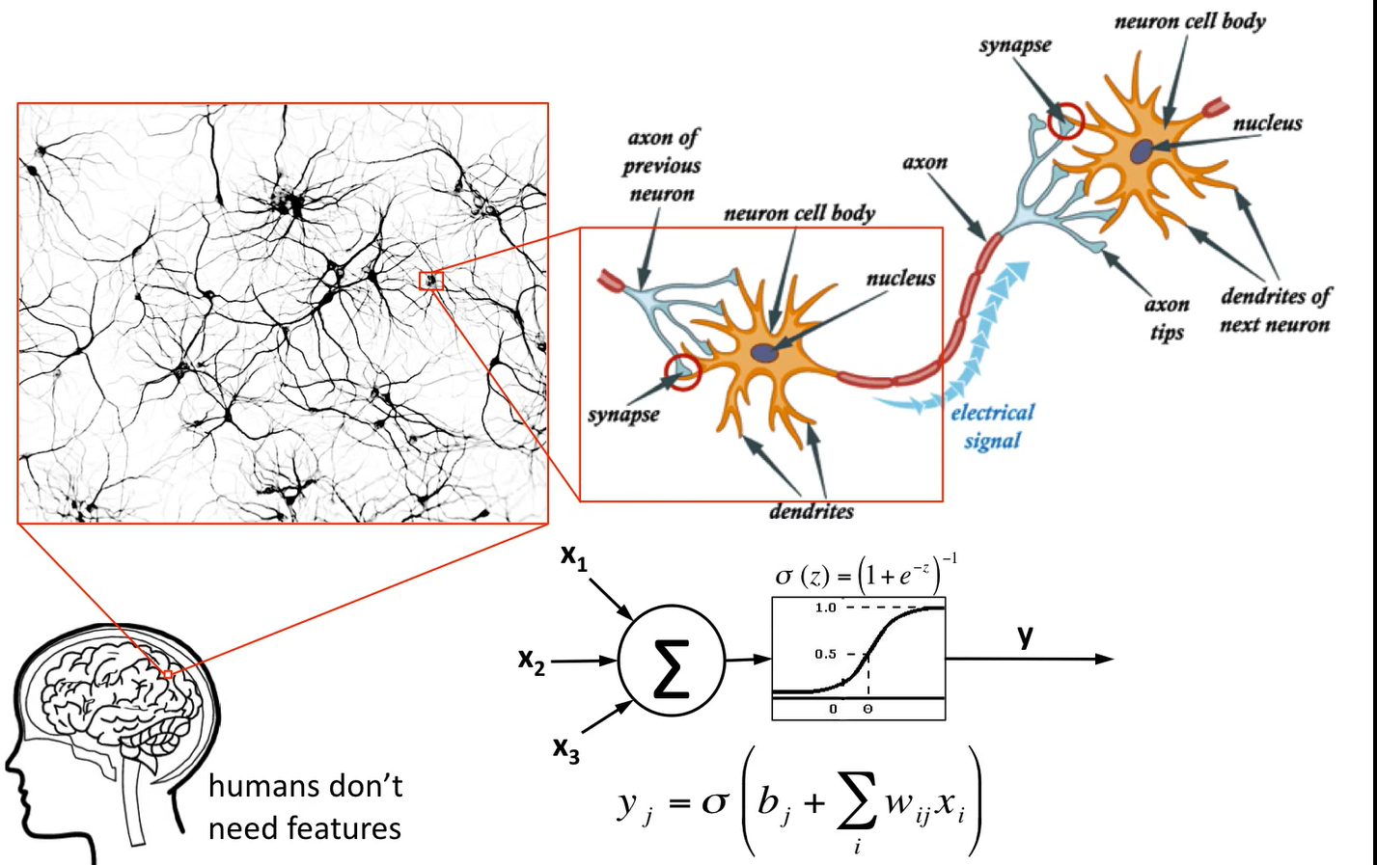
Neurons and The Brain
Credit : Victor Lavrenko

Slide 17
NN
Any non-linear function can be approximated with any accuracy by Multi-layer (a single layer) Perceptron

Slide 18
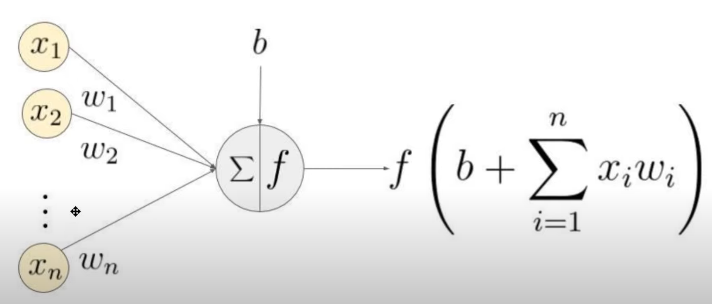

ANN Notations
Layers in an ANN $n_{l}$ - $l=1,2,3,…n_{l}$
Node/neuron/perceptron $i$ in layer $l$ - $a_{i}^{(l)}$
Weight connecting node $i$ in layer $l$ to node $j$ in layer $(l+1)$ as $w_{ij}^{(l)}$
The weight matrix between layer $l$ and layer $(l+1)$ is denoted as $W^{(l)}$

Slide 19

Backpropagation
For each output unit $i$ in layer $n_{l}$ set
Residual error/ Loss - $δ^{(n_{l})}=$ (derivative of the loss function of the $n_{l}$ layer with respect to $n_{l}$ layer activation )*(derivative of the activation function with respect to the $z^{n_{l}}$ before applying activation function )

Slide 20

Convolution
Correlation
$R\left(x\right)=f\left(x\right)\text{☆}g\left(x\right)=\int_{−∞}^{∞}{f\left(z\right)g\left(x+z\right)dz}$
$f\left(x\right)\text{☆}g\left(x\right)≠g\left(x\right)\text{☆}f(x)$
Convolution
$G\left(x\right)=f\left(x\right)⋆g\left(x\right)=\int_{−∞}^{∞}{f\left(z\right)g\left(x−z\right)dz}$
$f\left(x\right)⋆g\left(x\right)=g\left(x\right)⋆f\left(x\right)$
1D, 2D, 3D convolutions
Images
2D data → 2D Convolution
Kernal – 2D - $m×n$ – Kernal signal domain
$a=\frac{m−1}{2},b=\frac{n−1}{2}$ - a,b are assumed to be odd integers
$w⋆f\left(x,y\right)=\sum_{s=−a}^{a}{\sum_{t=−b}^{b}{\left[w\left(s,t\right)f\left(x−s, y−t\right)\right]}}$

Slide 21
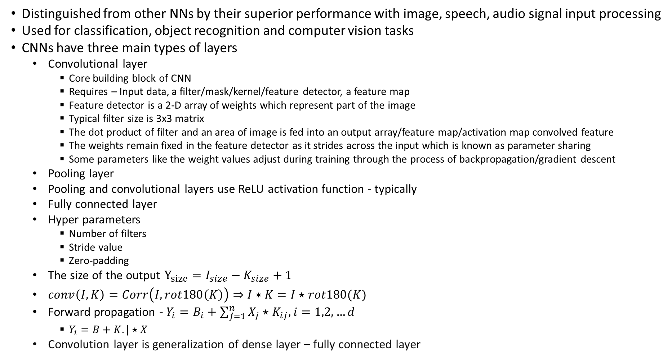
Convolutional Neural Networks
Distinguished from other NNs by their superior performance with image, speech, audio signal input processing
Used for classification, object recognition and computer vision tasks
CNNs have three main types of layers
Convolutional layer
Core building block of CNN
Requires – Input data, a filter/mask/kernel/feature detector, a feature map
Feature detector is a 2-D array of weights which represent part of the image
Typical filter size is 3x3 matrix
The dot product of filter and an area of image is fed into an output array/feature map/activation map convolved feature
The weights remain fixed in the feature detector as it strides across the input which is known as parameter sharing
Some parameters like the weight values adjust during training through the process of backpropagation/gradient descent
Pooling layer
Pooling and convolutional layers use ReLU activation function - typically
Fully connected layer
Hyper parameters
Number of filters
Stride value
Zero-padding
The size of the output $Y_{size}=I_{size}−K_{size}+1$
$conv\left(I,K\right)=Corr\left(I, rot180\left(K\right)\right)⇒I∗K=I⋆rot180(K)$
Forward propagation - $Y_{i}=B_{i}+\sum_{j=1}^{n}{X_{j}⋆K_{ij}, i=1,2,…d}$
$Y_{i}=B+K.|⋆X$
Convolution layer is generalization of dense layer – fully connected layer

Slide 22
CNN
Multiple hidden layers
CNN layers
Convolutional layer
Convolved feature or activation map
Activation function – ex. ReLU
Pooling Layer
Fully Connected Layer
Multiple kernels
16 Kernels → 16 Convolutions →16 Feature Maps → 16 Activation Maps → Pooling → 16 pooled output
Hyper parameter
Number of Kernels (Feature maps)
Stride
The weights of the kernels are the network of parameters to be learnt
Pooling layer
Down sampling operation that reduces the dimensionality of the feature map
Rectified feature map goes through a pooling layer to generate a pooled feature map
Pooling operation/kernel size is the size of the filter matrix used for pooling the feature map
Uses various filters to identify different parts of the image like edges, corners, body, feathers, eyes, and beak
Each pooled output is flattened – conversion of 2-dimensional pooled map into long continuous linear vector
GANs are a class of CNNs

Slide 23
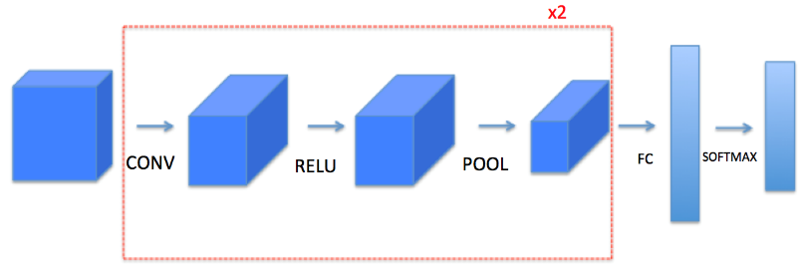
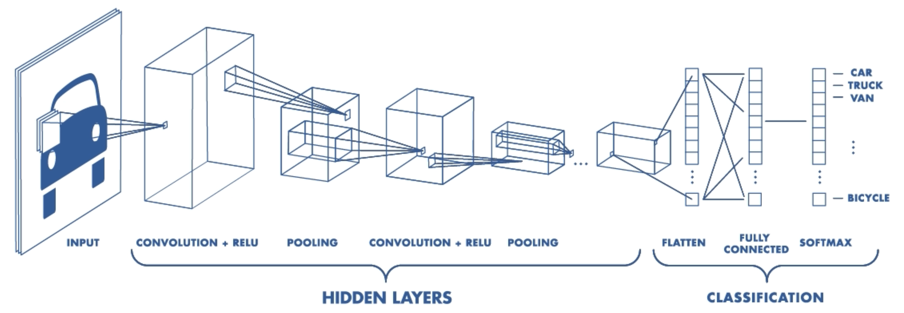
CNN – Implementation Layers

Slide 24
Using CNNs
3 Ways
Train from Scratch
Highly accurate
Thousands of images
Significant compute resources
Transfer Learning
Pre-trained CNNs for solving similar new problems
Trained on cats and dogs and fine tuned for cars and trucks
Feature Extraction from Pre-trained CNNs
Pre-trained CNN for SVM, decision tree etc.

Slide 25
CNN Vs NN
Neural Networks
Lack of scalability for image processing – bigger size images require higher computational power and resources
Problem of over-fitting – learns too many details in the training data inclusive of the noise which affects the performance on unseen data
NN fails to identify features or patterns in the image/data set
CNN
Uses parameter sharing – layers’ filters move across the image, the weights remain fixed – making CNN computationally less intensive
Kernel weights are learned and fixed and same kernel for the whole convolution

Slide 26
CNNs State of the Art
Weight parameters of kernel/filter are learned through training
Softmax normalizes the output class vector of dense layer into normalized vector where the sum of all elements (probabilities) is equal to 1
CNN architectures
Large scale data
ImageNet – 1K
Train – 1.28M
Validation (hyper parameter tuning) : 50K
Test : 100K
Classes: 1000
ImageNet
Train – 14.197M
Classes – 21,841

Slide 27
Thank you
Brillium Technologies
#501, C Block, Salarpuria Serenity, 5th Main, Sector 7, HSR Layout, Bengaluru 560102, Karnataka, India
Website: www.brillium.in | Email: connect@brillium.in

